Slide 1

Supernova Programming Language
Version 1.3
Free-Open Source
2009-2010, Mahmoud Fayed (msfclipper@yahoo.com)

Slide 2


Keynote Roadmap
Introduction to Supernova PL
Hello World Program
Supernova and Human Languages
Instructions and Rules
Multi-Language Source code
Language Design.
Samples
Using Notepad++
Supernova developed using PWCT
Supernova Resources
Summary

Slide 3
Introduction
The Supernova programming language is a modern scripting language and the first one presents the concept of programming with direct Fiction Description using clear subset of pure Human Language
The programs are one or more of paragraphs (collection of statements).
High level of writing flexibility.
Multi-Language source code (Arabic, English & Mixed).
Instructions execution model is Event-Driven
Hybrid Implementation (Compiler & Virtual Machine).

Slide 4
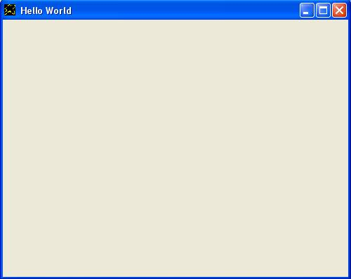
Hello World Program
I want window and the window title is Hello World.

Slide 5
Supernova and Human Languages
Supernova is a language tends to be more near to our human language where we do Programming With Fiction Description (PWFD) using subset of Pure human language
The human language is VERY big and contains many words so we use a subset of it to **Reduce the Complexity** of the problem and to **Get Acceptable Performance** as much as we can

Slide 6
Supernova and Human Languages
Unlike other programming languages which is based on statements Supernova is based on Paragraphs which contains many statements packed together using ignored words like (the, and,...etc)
For example the two commands:-
(1) I want window (2) Window title is hello.
May be connected together to form another big statement
I want window and the window title is hello.

Slide 7
Instructions and Rules
Language statements has a rule describe its structure and help users to use and remember the statement in the future.
Rule: PVC
[P] = Pronoun
[V] = Verb
[C] = Class
Statement = I Want Window

Slide 8
Instructions and Rules
Rule: CAVD
[C] = Class
[A] = Attribute
[V] = Verb
[D] = Data
Statement = Window Title is hello world.

Slide 9
Multi-Language Source Code
Supernova is a Multi-language where the source code may be written Using (Arabic, English, Mixed...etc) code
For example The English program
I want window and the window title is wow.
Can be rewritten in Arabic language
.انا اريد نافذة والنافذة تحت عنوان هو واو

Slide 10
Language Design
With respect to the design of the language
And unlike other programming languages
Which uses Context-Free Grammar,
Supernova use a Context-Sensitive Grammar
To get a language more near to our human
Language as much as we can

Slide 11
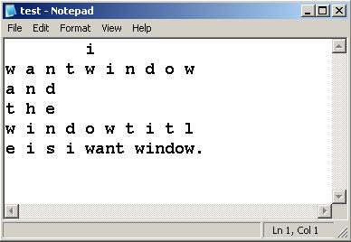
Language Design

Slide 12
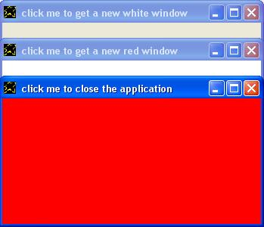
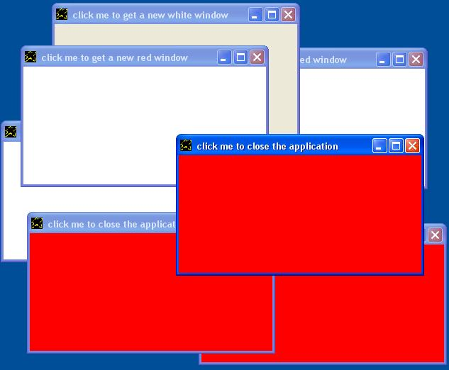
Samples
Click – Loop Sample

Slide 13

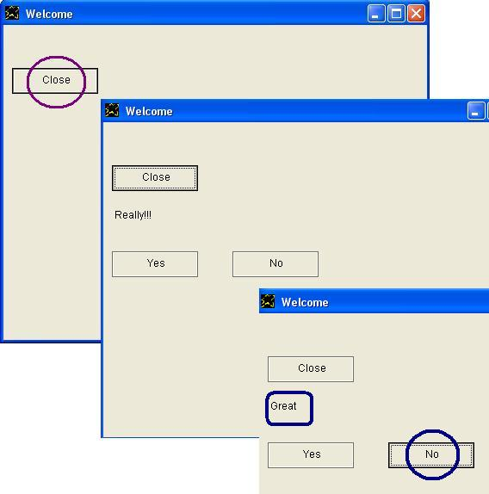
Samples
Shutdown Sample

Slide 14
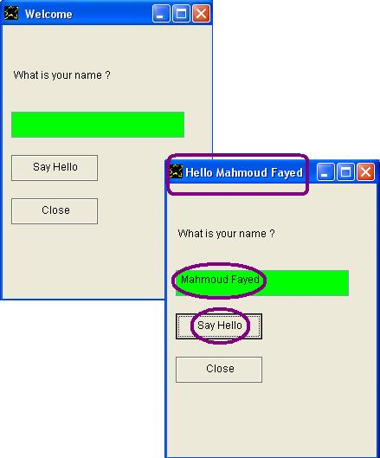
Samples
Question Sample

Slide 15
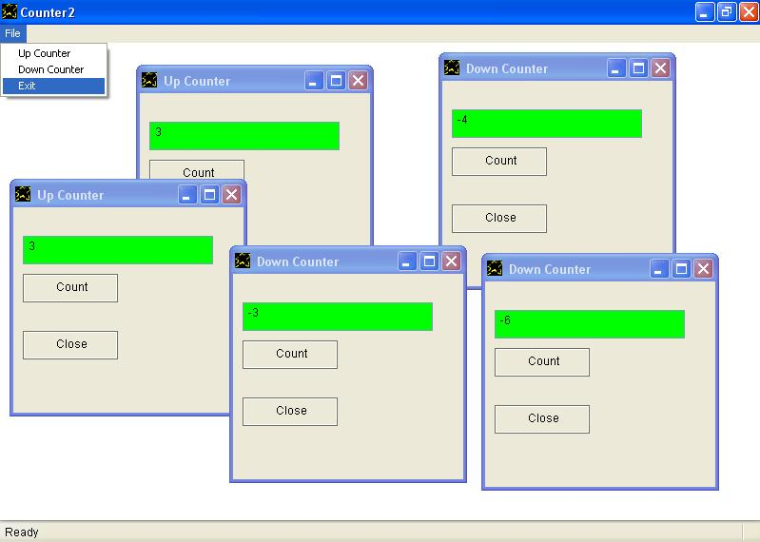
Samples
Counter Sample

Slide 16
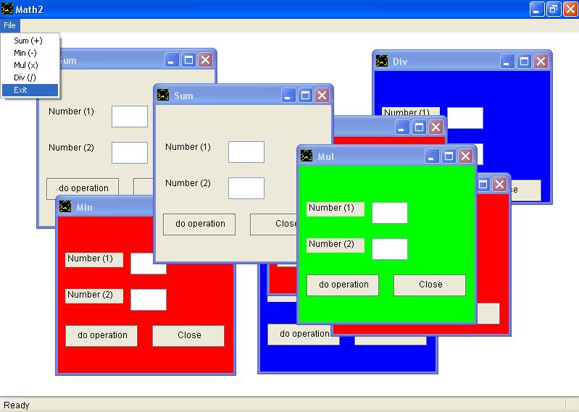
Samples
Math Sample

Slide 17
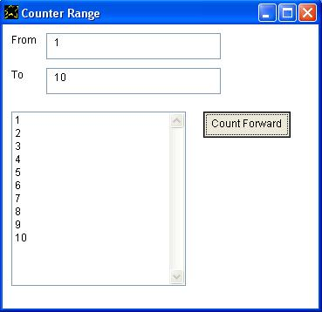
Samples
Counter-Range Sample

Slide 18
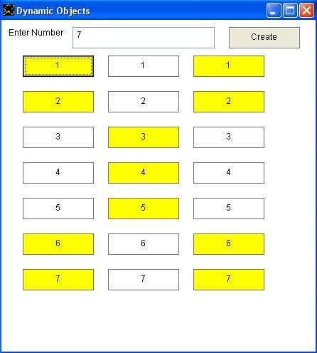
Samples
Dynamic Objects Sample

Slide 19
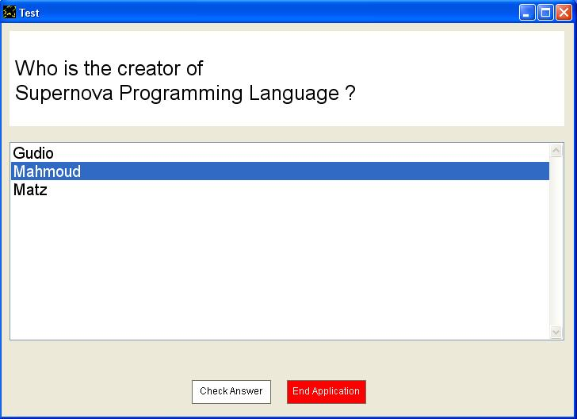
Samples
Check Answer Sample

Slide 20
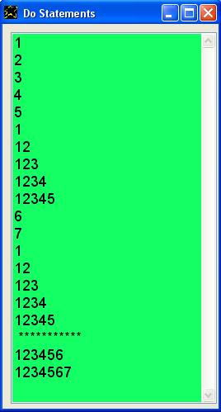
Samples
Do-Statements Sample

Slide 21
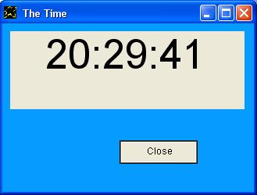

Samples
The-Time Sample

Slide 22
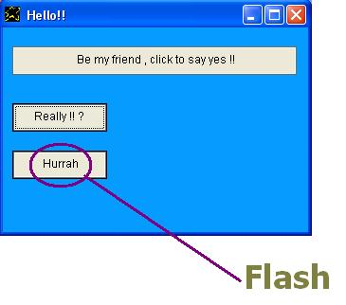
Samples
Flash Sample

Slide 23
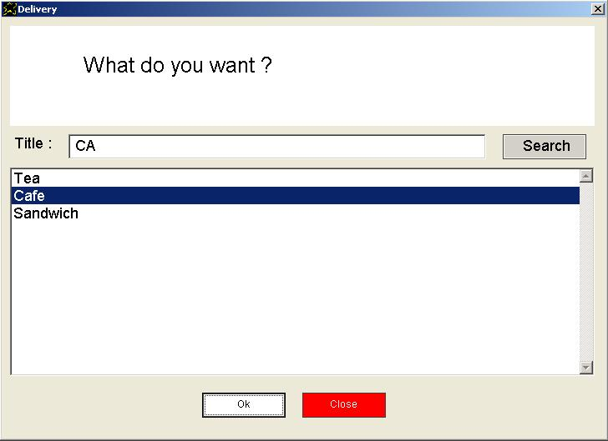
Samples
Delivery Application

Slide 24
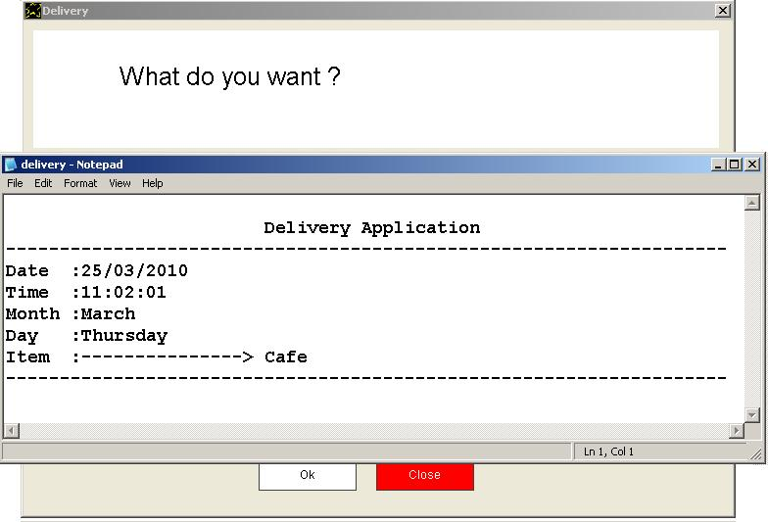
Samples
Delivery Application

Slide 25
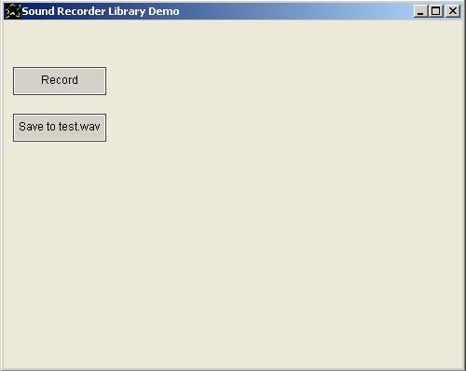
Samples
Sound-Recorder

Slide 26
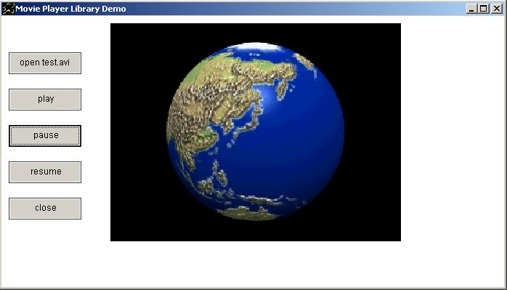
Samples
Movie-Player

Slide 27
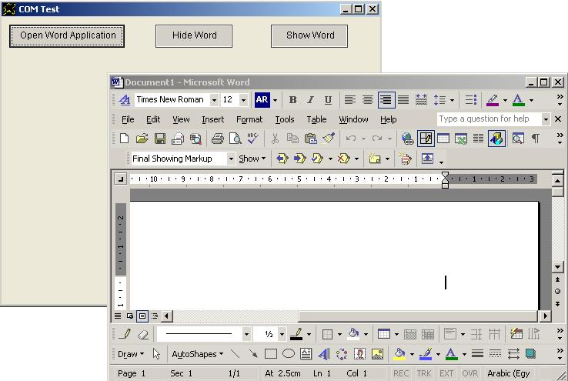
Samples
COM Sample

Slide 28
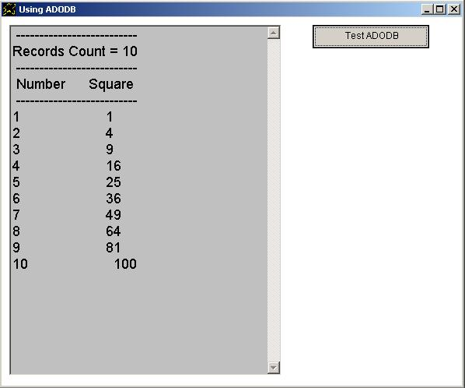
Samples
ADODB Sample

Slide 29
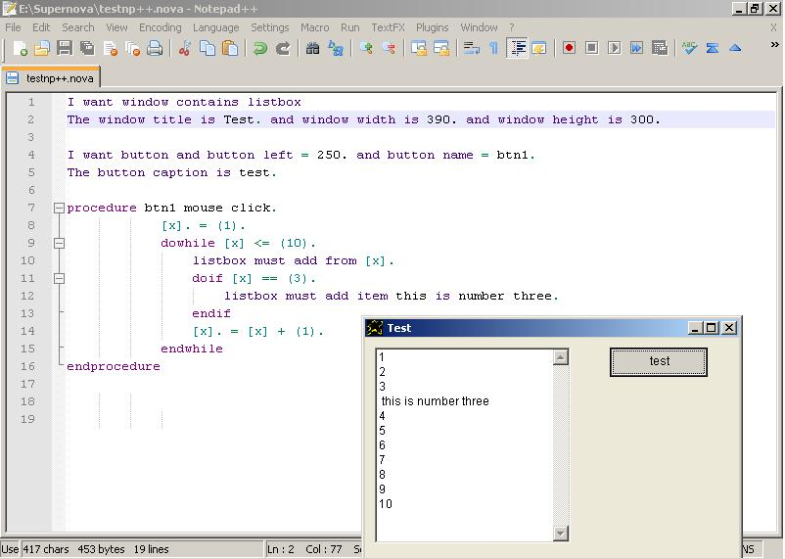
Using Notepad++

Slide 30
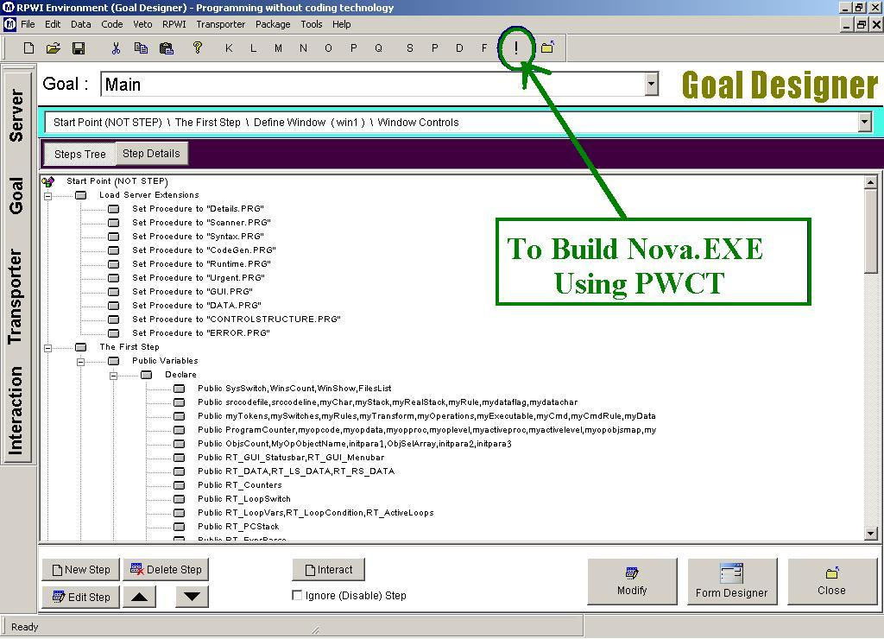
Supernova developed using PWCT

Slide 31
Supernova Resources
Supernova web site on sourceforge.net
  http://supernova.sourceforge.net
    News
    Download
    Documentation

Slide 32
Summary
Free-Open Source
Programming With Fiction Description
Writing Flexibility
Small Size (Less than 15 MByte)
Multi-Language Source code (Arabic & English)
Build GUI Applications
Distribute Executable Applications (*.EXE)
Extension (calling DLL Functions & using COM )
Developed using PWCT

